Slide 1
Deep Code Representation and Comment Generation: An Introduction
Narrator: Yao Wan
Zhejiang University
wanyao@zju.edu.cn
Mar 20, 2020

Slide 2
Contents
Background (25min)
Code representation (RNN, CNN, Transformer)
Text generation (language model, reinforcement learning, GAN)
Code Comment Generation (Code Summarization) (10min)
Motivation
Methodology
Experiment
Discussion and Future directions (4min)
Conclusion (2min)

Slide 3
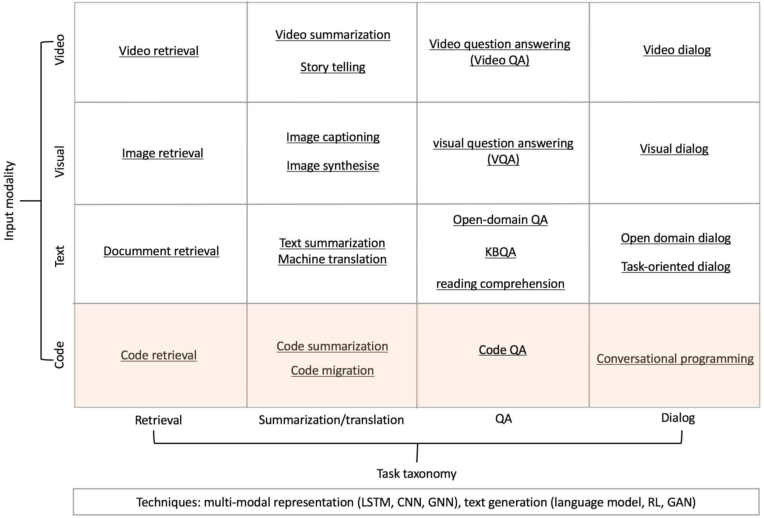
Where we are ?
+more…
clone detection,
bug localization,
program synthesis (completion),
vulnerability detection, and so on

Slide 4
Contents
Background (25min)
Code representation (RNN, CNN, Transformer)
Text generation (language model, reinforcement learning, GAN)
Code Comment Generation (Code Summarization) (10min)
Motivation
Methodology
Experiment
Discussion and Future directions (6min)
Conclusion (2min)
Notes:
Firstly, let’s come to the Background part.

Slide 5
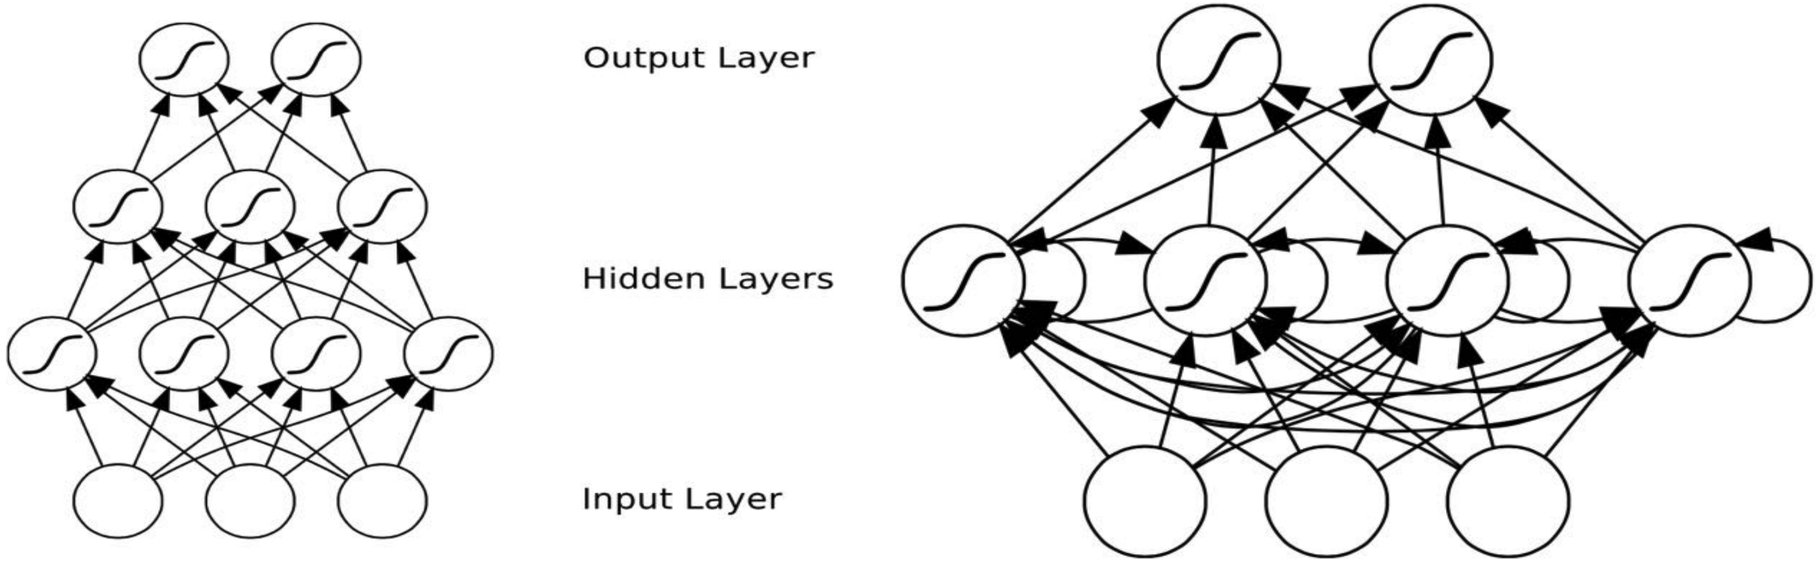
MLP v.s. RNN
MLP: only map from input to output vectors
RNN: map from the entire history of previous inputs to each output
MLP
RNN
Notes:
A perceptron is always feedforward, that is, all the arrows are going in the direction of the output. Neural networks in general might have loops, and if so, are often called recurrent networks. A recurrent network is much harder to train than a feedforward network.

Slide 6
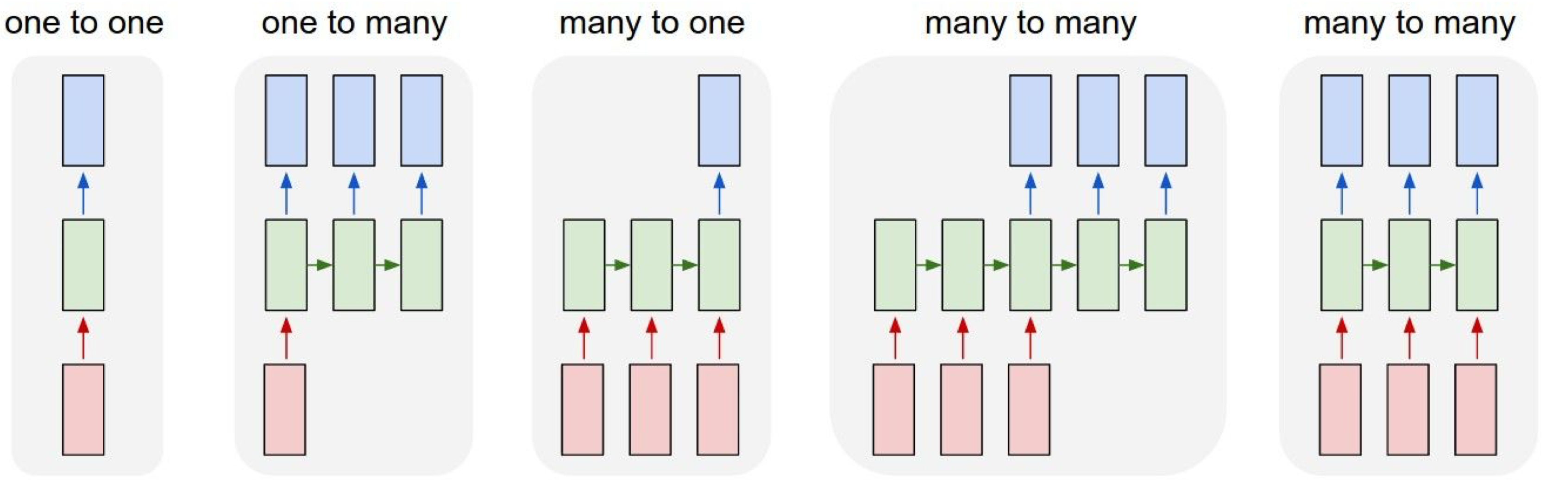
RNN offers a lot of flexibility
Vanilla NN
Image captioning
Sentiment classification
Machine translation
Video classification on frame level
Notes:
RNN offers a lot of flexibility for different scenarios.
Here we first define an encoder-decoder framework. The encoder tries to embed the input into a hidden state and then the decoder decode the hidden state into another space.
According the lengths of input and output, we split the tasks into these five categories.

Slide 7
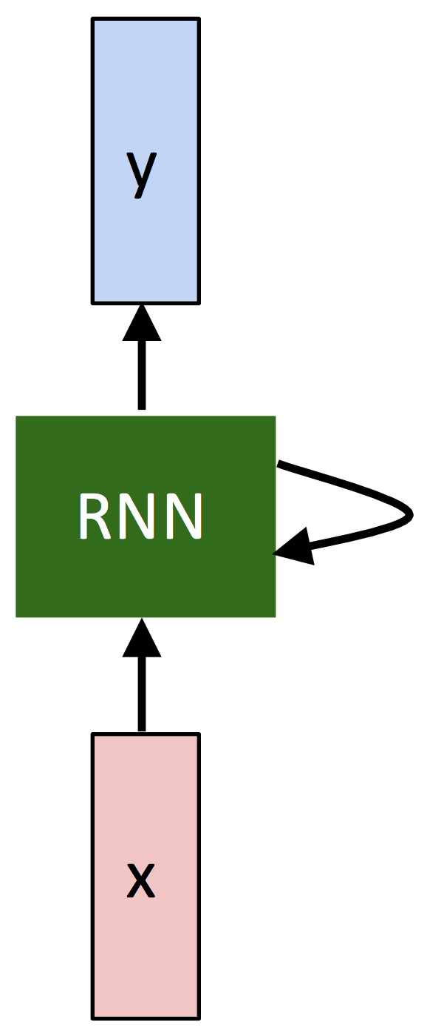
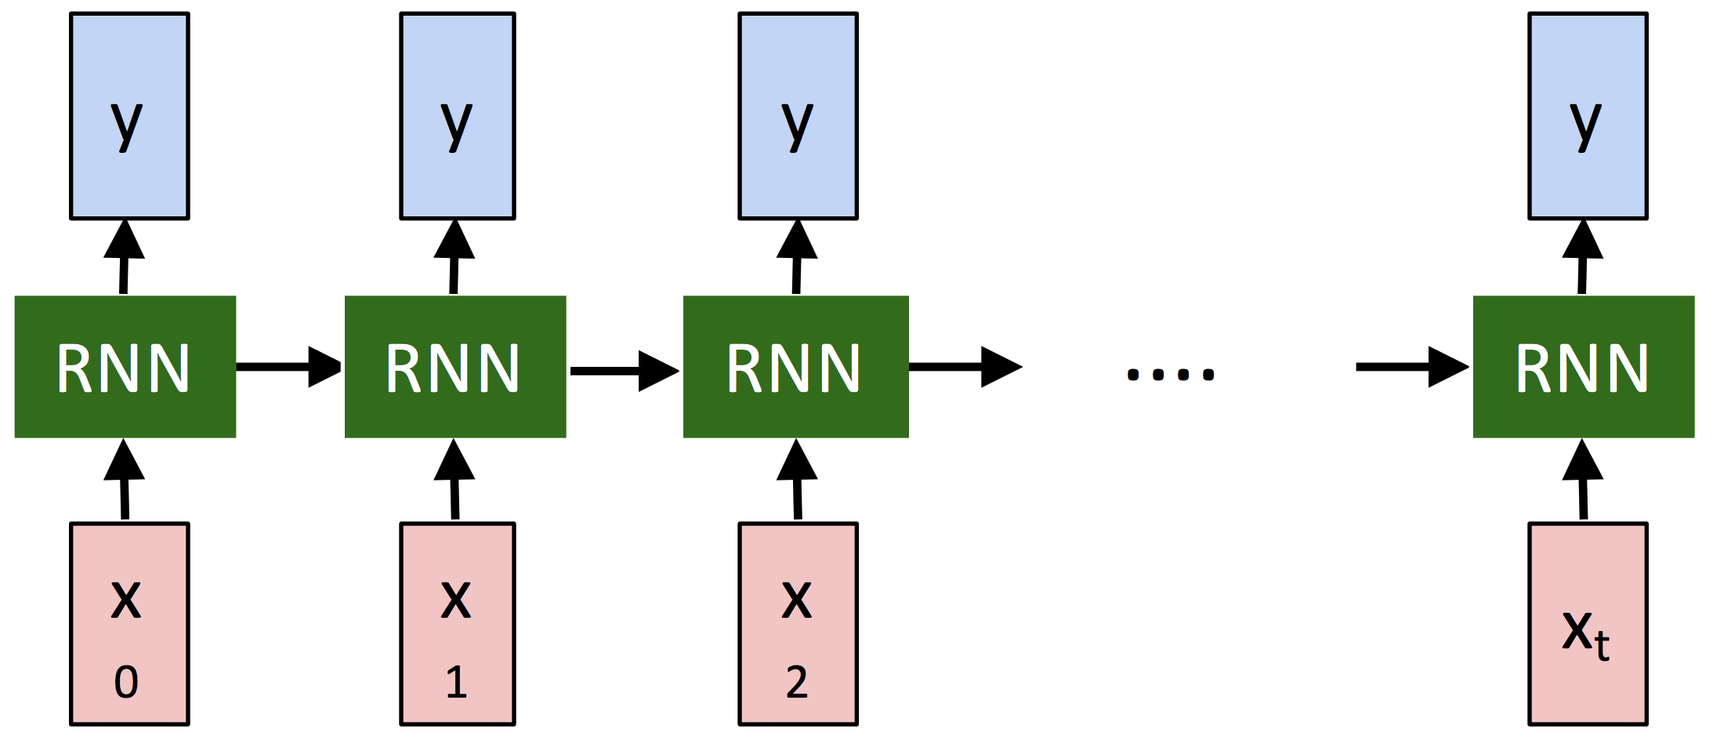
Recurrent Neural Network
=
A recurrent neural network can be thought of as multiple copies of the same network, each passing a message to a successor.
Notes:
This picture describes the network architecture of RNN.
This chain-like nature reveals that recurrent neural networks are related to sequences and lists. They’re the natural architecture of neural network to use for such data.
Specifically, a recurrent neural network can xxx
The so-called recurrent is essentially a copy of a network (parameter sharing), and then the message is passed to the next time step.

Slide 8
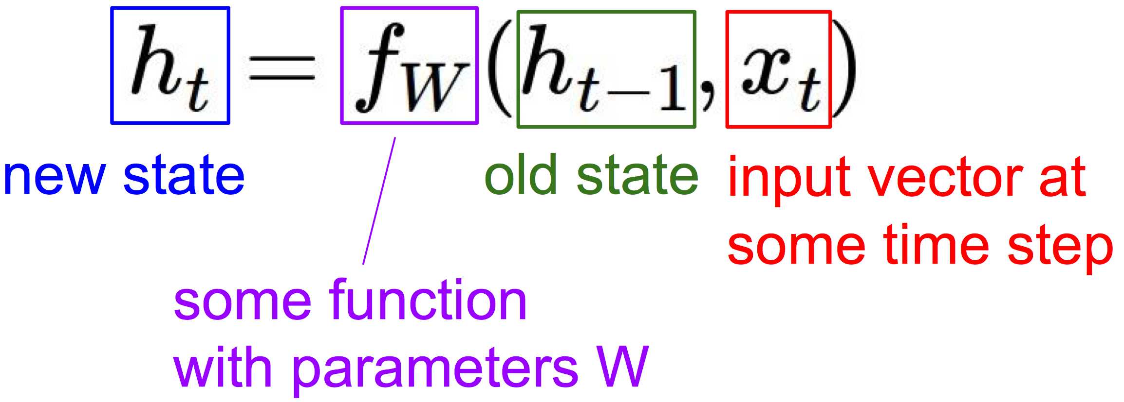
Recurrent Neural Network
We can process a sequence of vectors x by applying a recurrence formula at every time step:
Important: the same function and the same set of parameters are used at every time step (i.e., sharing parameter W).
Notes:
Formally, we can process a sequence of vectors x by applying a recurrence formula at every time step:

Slide 9
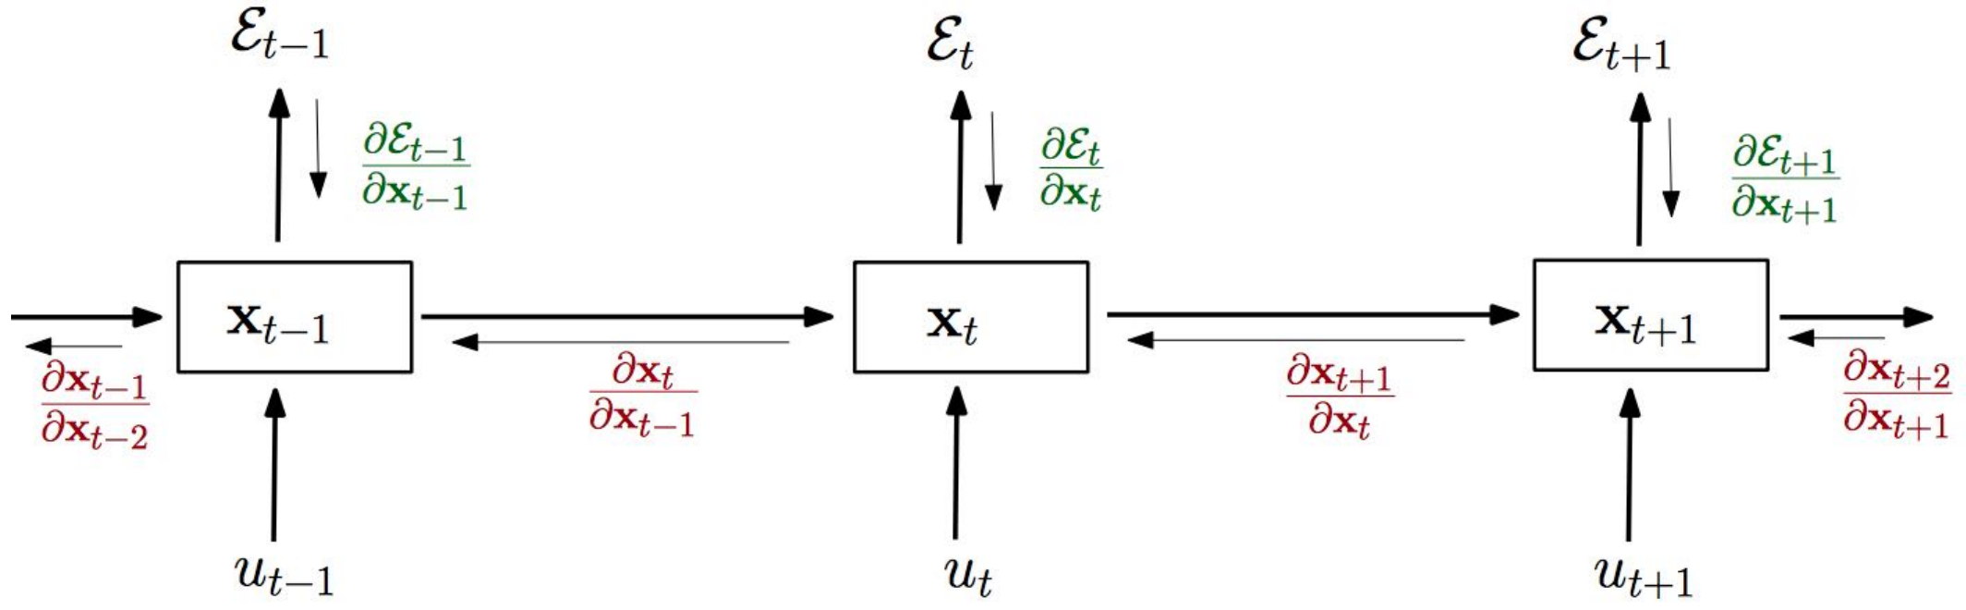
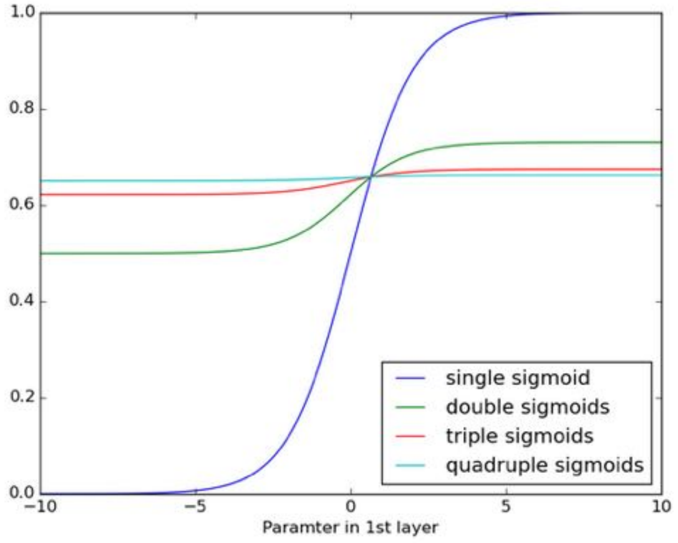
Issue 1: Gradient Vanishing
BPTT (Back Propagation Through Time)
If the gradients are large
Exploding gradients, learning diverges
Solution: clip the gradients to a certain max value.
If the gradients are small
Vanishing gradients, learning very slow or stops
Solution: introducing memory via LSTM, GRU, etc.
Notes:
- However the vallina RNN suffers two critical issues: the first one is gradient vanishing.
The first thing we need to know is the BPTT, which is a fundamental technique that make training deep neural netwosk feasible.
This picture shows the process of BPTT. epsion the the output of each time step. x is the hidden state of each time step. When we calculate a loss in the end time step, we back propagate the supervised signal. We can find that, x_t+1 is dependent on x_t
- In the end, the gradient signal can end up being multiplied a large number of times.

Slide 10
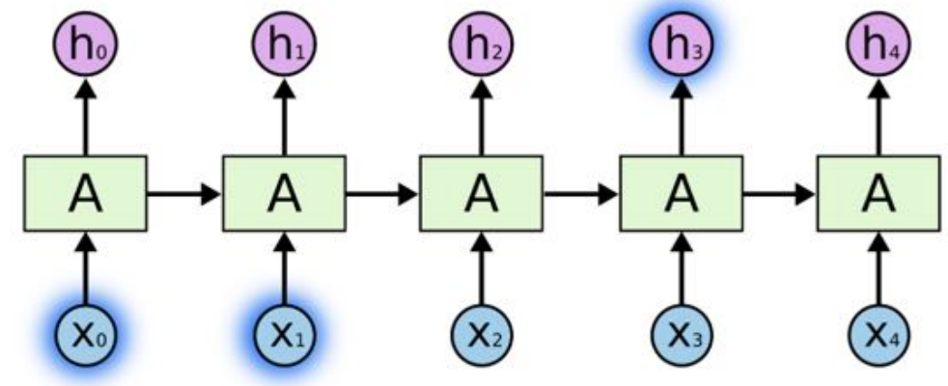
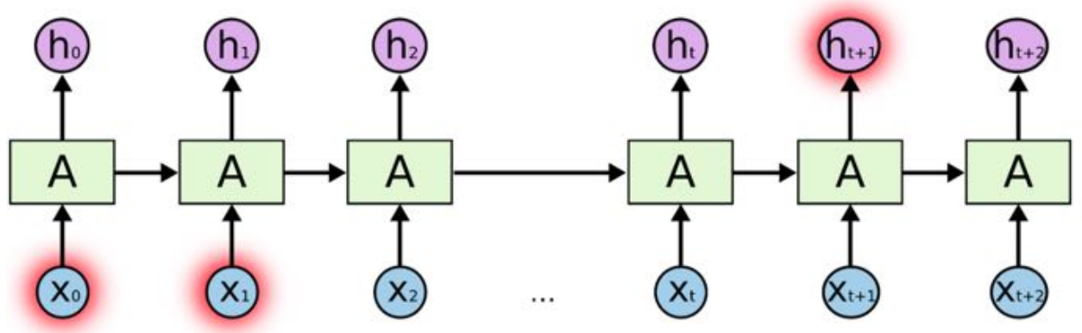
Issue 2: Long-Term Dependencies
(Vanilla) RNNs connect previous information to present task:
enough for predicting the next word for “the clouds are in the sky”
may not be enough when more context is needed i.e., “I grew up in France… I speak fluent French.”
Notes:
Another issue for RNN is the long-term dependencies,

Slide 11


Long-Short Term Memory (LSTM)
A memory cell using logistic and linear units with multiplicative interactions.
[Hochreiter & Schmidhuber (1997)]
Notes:
These two aforementioned issues motivate us to design a network to selectively memory something or forget something.
That is LSTM, which has been widely used in natural language processing.
This kind of netwok contains a memory cell xxx

Slide 12
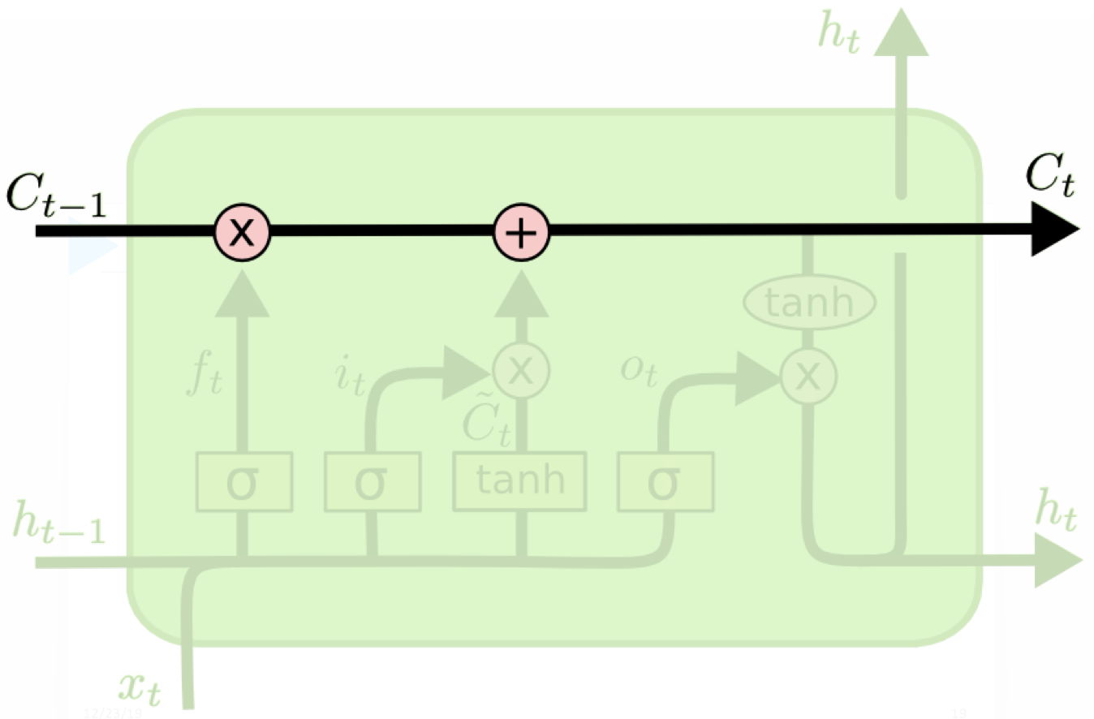
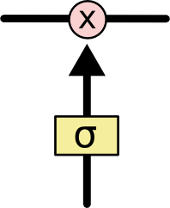
The Core Idea Behind LSTMs : Cell State
Memory
Gate
An LSTM has three gates, to protect and control the cell state.
Notes:
- The key to LSTMs is the cell state, the horizontal line running through the top of the diagram.
The LSTM does have the ability to remove or add information to the cell state, carefully regulated by structures called gates.
The sigmoid layer outputs numbers between zero and one, describing how much of each component should be let through. A value of zero means “let nothing through,” while a value of one means “let everything through!”
- Actually, LSTM controlls the information flow through cell state via three gates, namely the forget gate, input gate and output gates.
- We will elaborate each gate one by one.

Slide 13

LSTM - Forget Gate
Notes:
The first gate is forget gate which is to decide what information we’re going to throw away from the cell state.
The input of forget gate is the previous hidden state h_t-1 and the current input x_t.

Slide 14
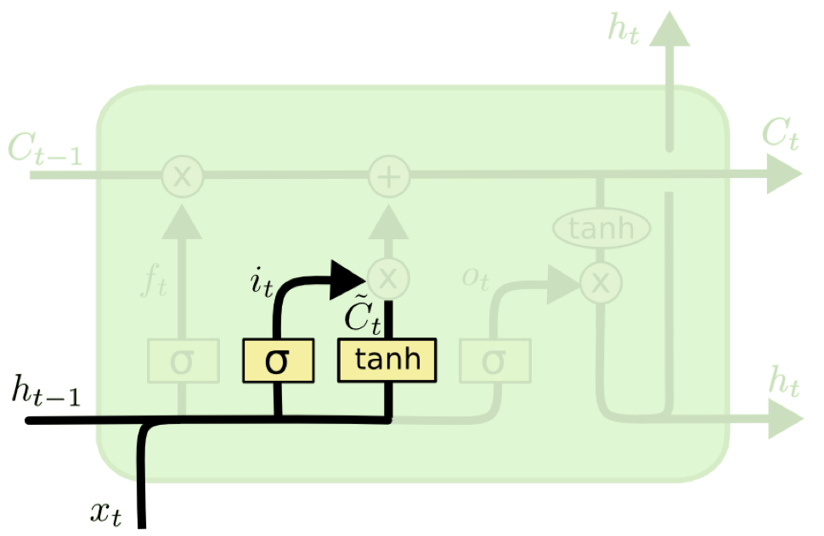
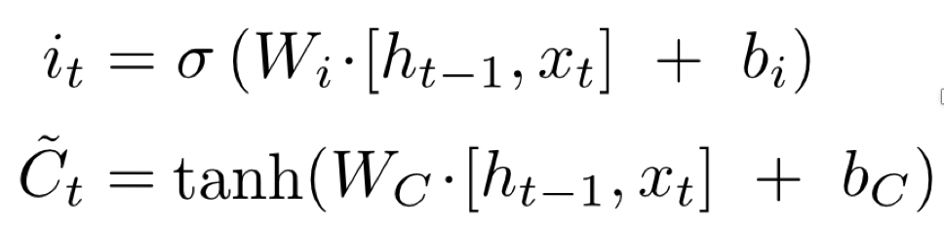
LSTM - Input Gate & Cell State
Input gate:
Added cell state:
Notes:
In the forget we have selectively forget some information, here we need to decide what new information we’re going to store in the cell state. First, a sigmoid layer called the “input gate layer” decides which values we’ll update. Next, a tanh layer creates a vector of new candidate values, that could be added to the state.

Slide 15

LSTM - Input Gate & Cell State
It’s now time to update the old cell state into the new cell state.
new cell state
old cell state
added cell state
Notes:
- In the next step, we’ll combine these two to create an update to the state

Slide 16

LSTM - Output Gate
Notes:
Finally, we need to decide what we’re going to output, based on our cell state.
First, we run a sigmoid layer which decides what parts of the cell state we’re going to output. Then, we put the cell state through tanh and multiply it by the output of the sigmoid gate, so that we only output the parts we decided to.

Slide 17
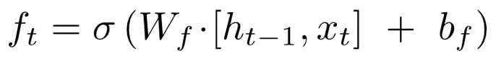
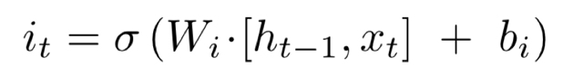

Variants 1: GRU
It combines the forget and input gates into a single “update gate.”
It also merges the cell state and hidden state.
[Cho et al. (2014) ]
Notes:
It combines the forget and input gates into a single “update gate.”
It also merges the cell state and hidden state, and makes some other changes.

Slide 18
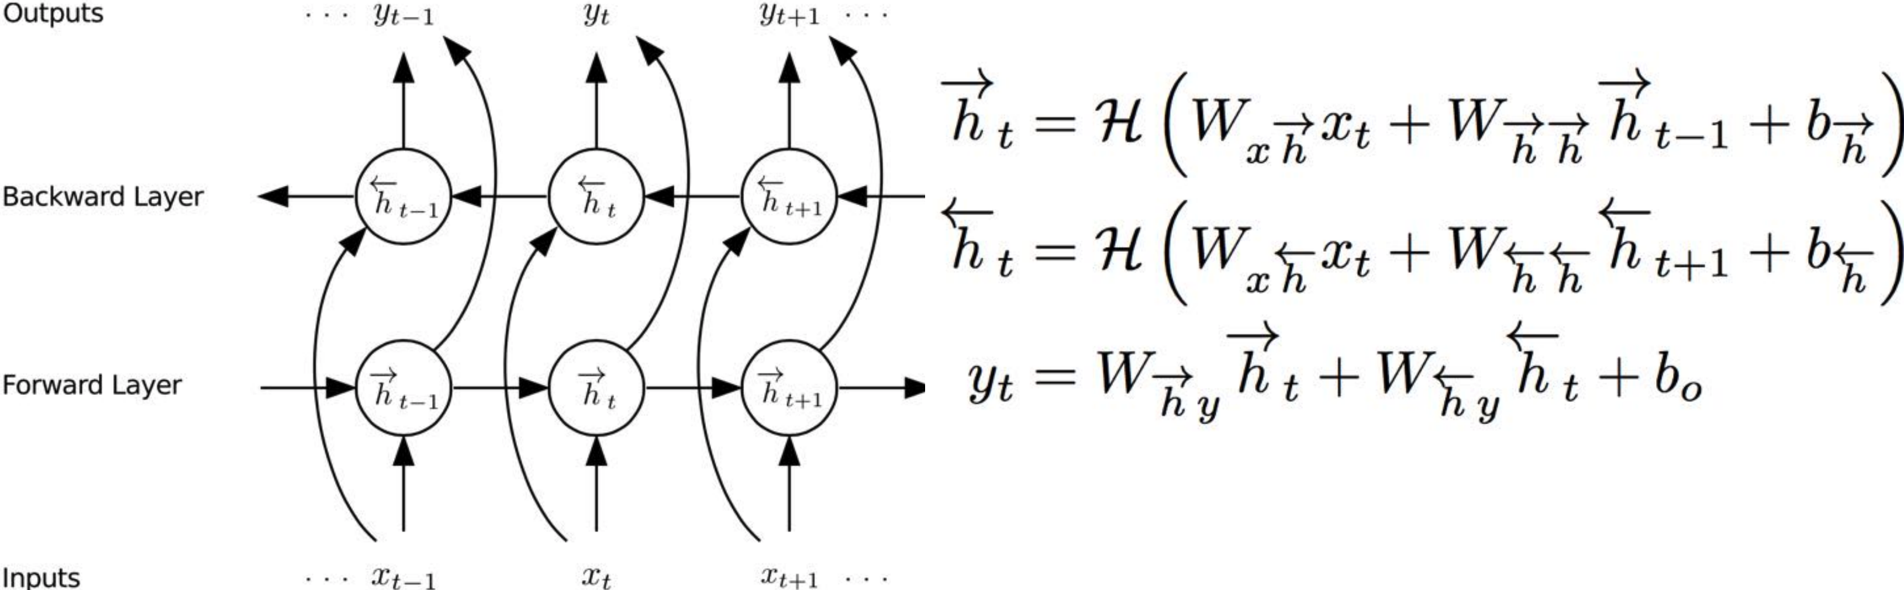
Variants 2: Bi-RNN
Bi-RNNs process the data in both directions with two separate hidden layers:
Forward hidden sequence: iterates from t=1:T
Backward hidden sequence: iterates from t=T:1

Slide 19
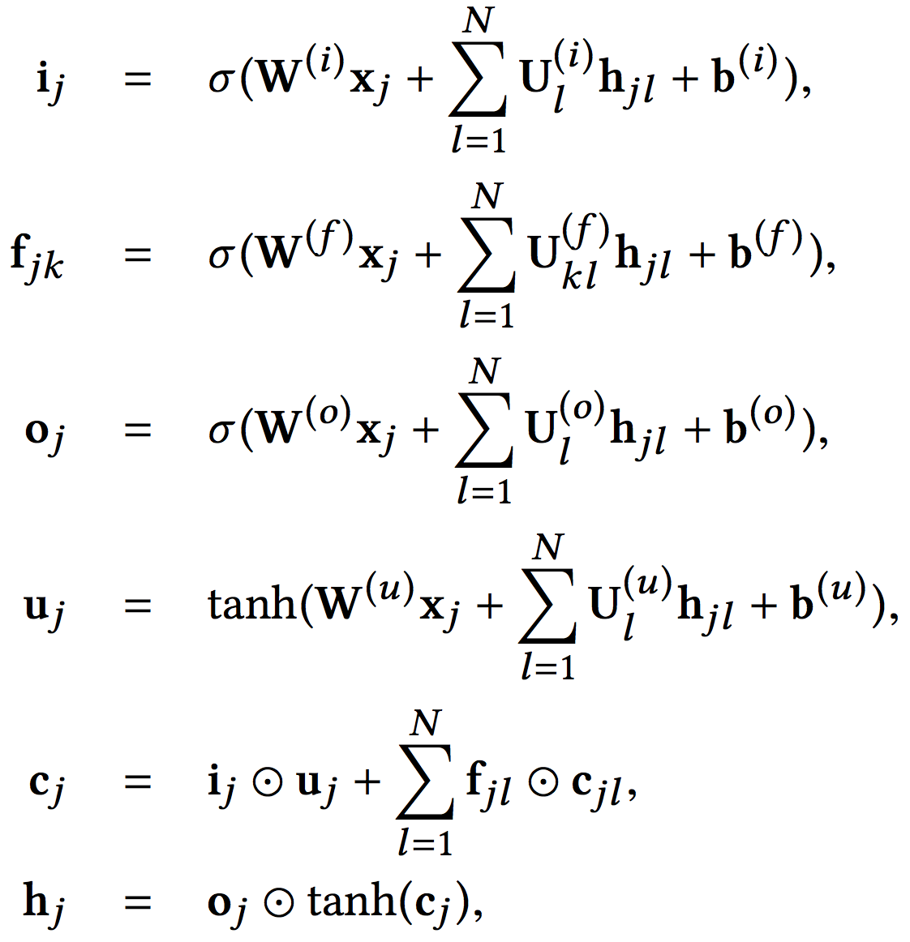
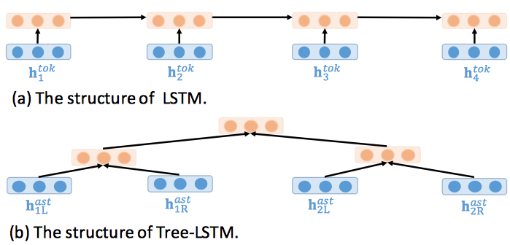
Variants 3: Tree-LSTM
Binary Tree:

Slide 20
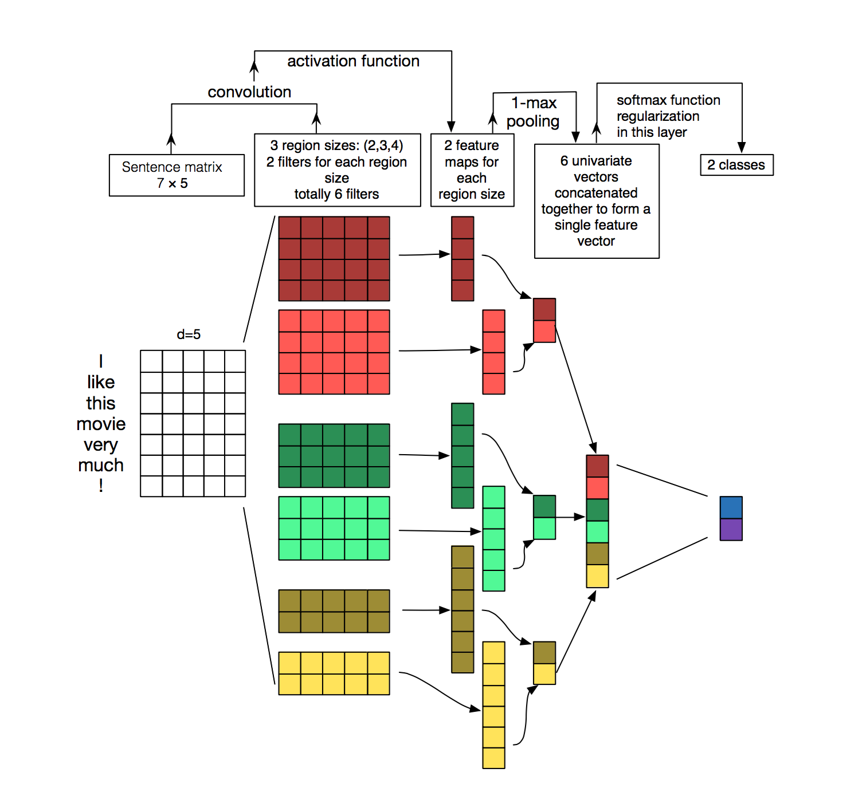
CNN
Notes:
The convolutional neural networkis is orginal designed for represent the image, which has the capability of capturing the spatial information.
Recently, the CNN has also been introducted to indirectly represent the sequential text, since the CNN is more faster than RNN.
for text we fix kernel size to filter_size x embed_size, i.e. (3,300) we are just going to move vertically down for the convolution taking look at three words at once since our filter size is 3 in this case.
Also we can think of filter sizes as unigrams, bigrams, trigrams, etc. Since we are looking at a context window of 1,2,3, and 5 words respectively.

Slide 21
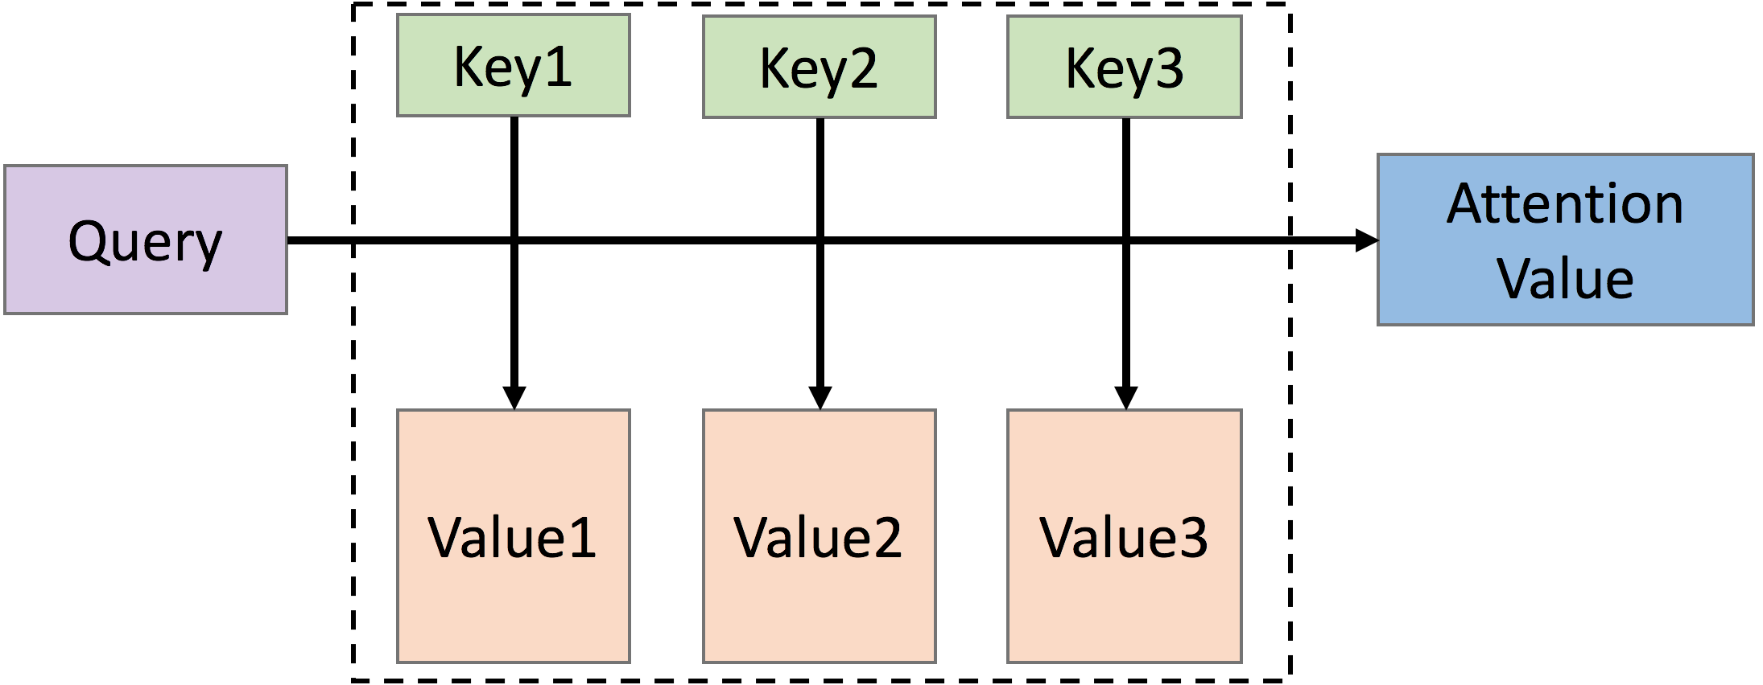
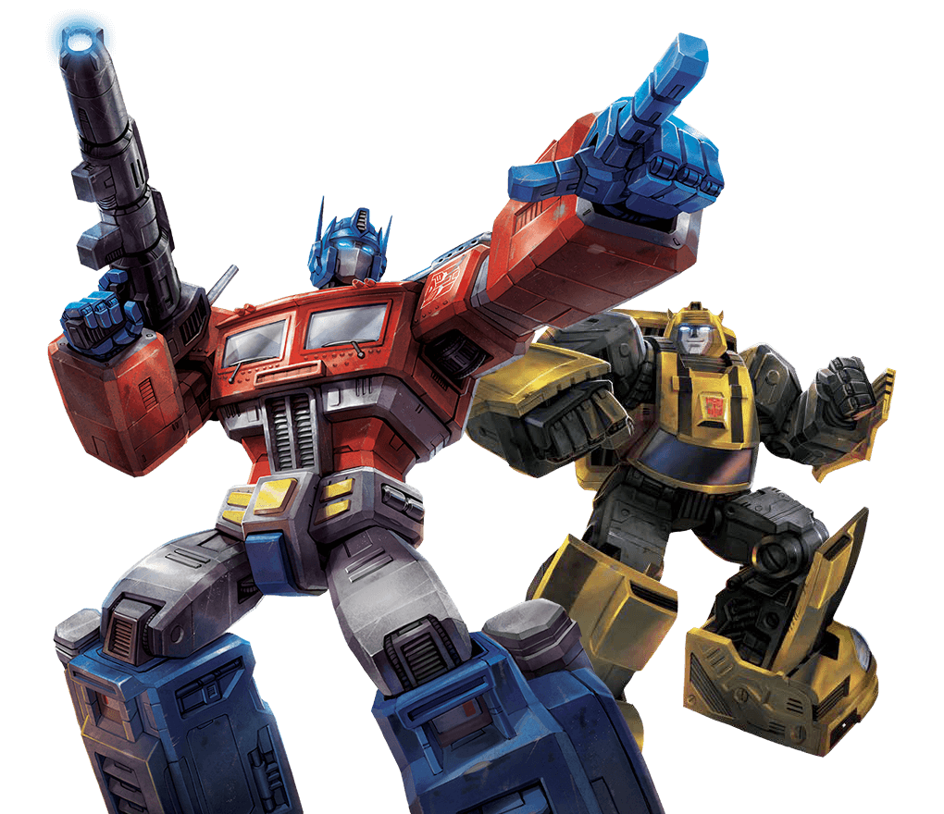
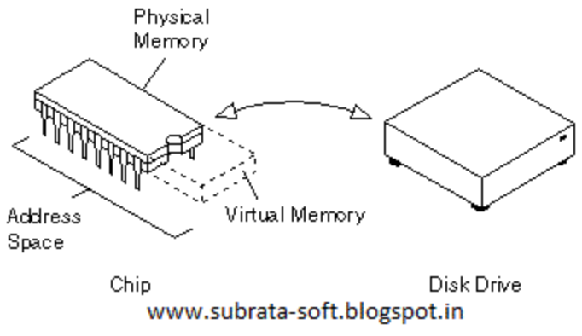
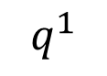
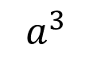
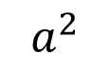
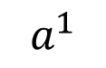
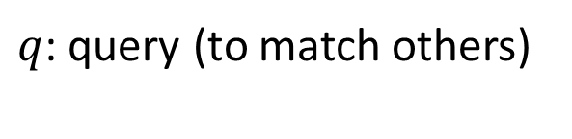
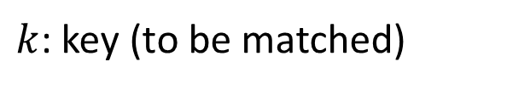
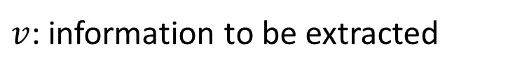
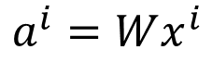
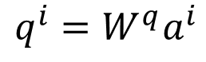
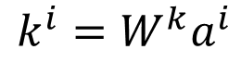
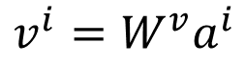
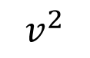
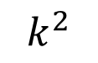
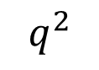
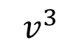
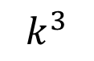
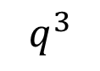
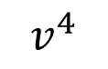
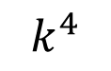
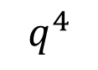
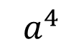
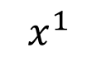
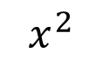
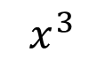
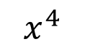
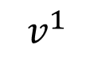
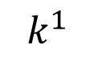
Self-attention
$q$: query (to match others)
https://arxiv.org/abs/1706.03762
$$q^{i}=W^{q}a^{i}$$
$k$: key (to be matched)
$$k^{i}=W^{k}a^{i}$$
Transformer
Attention is all you need.
$v$: information to be extracted
$$v^{i}=W^{v}a^{i}$$
$$q^{1}$$
$$k^{1}$$
$$v^{1}$$
$$q^{2}$$
$$k^{2}$$
$$v^{2}$$
$$q^{3}$$
$$k^{3}$$
$$v^{3}$$
$$q^{4}$$
$$k^{4}$$
$$v^{4}$$
$$a^{1}$$
$$a^{2}$$
$$a^{3}$$
$$a^{4}$$
$$a^{i}=Wx^{i}$$
$$x^{1}$$
$$x^{2}$$
$$x^{3}$$
$$x^{4}$$
Notes:
- parallelized.
- the attention mechanism can be seen as the process of soft-addressing in a memory unit. The source, composed of key k and value v, can be seen as the content of memory. Given an input query, the goal of attention mechanism is to return an attention value.

Slide 22






Self-attention
d is the dim of $q$ and $k$
Scaled Dot-Product Attention:
$$α_{1,i}=q^{1}∙k^{i}/\sqrt{d}$$
dot product
$$α_{1,1}$$
$$α_{1,2}$$
$$α_{1,3}$$
$$α_{1,4}$$
$$q^{1}$$
$$k^{1}$$
$$v^{1}$$
$$q^{2}$$
$$k^{2}$$
$$v^{2}$$
$$q^{3}$$
$$k^{3}$$
$$v^{3}$$
$$q^{4}$$
$$k^{4}$$
$$v^{4}$$
$$a^{1}$$
$$a^{2}$$
$$a^{3}$$
$$a^{4}$$
$$x^{1}$$
$$x^{2}$$
$$x^{3}$$
$$x^{4}$$
Notes:
Given a query q, we attend it on each key to calculate the attention weights.

Slide 23





Self-attention
$${\hat{α}}_{1,i}=exp\left(α_{1,i} \right)/\sum_{j}{exp\left(α_{1,j} \right)}$$
$${\hat{α}}_{1,1}$$
$${\hat{α}}_{1,2}$$
$${\hat{α}}_{1,3}$$
$${\hat{α}}_{1,4}$$
Soft-max
$$α_{1,1}$$
$$α_{1,2}$$
$$α_{1,3}$$
$$α_{1,4}$$
$$q^{1}$$
$$k^{1}$$
$$v^{1}$$
$$q^{2}$$
$$k^{2}$$
$$v^{2}$$
$$q^{3}$$
$$k^{3}$$
$$v^{3}$$
$$q^{4}$$
$$k^{4}$$
$$v^{4}$$
$$a^{1}$$
$$a^{2}$$
$$a^{3}$$
$$a^{4}$$
$$x^{1}$$
$$x^{2}$$
$$x^{3}$$
$$x^{4}$$
Notes:
Then we apply a softmax layer to normalize the attention weights.

Slide 24






Self-attention
$$b^{1}=\sum_{i}{{\hat{α}}_{1,i}v^{i} }$$
Considering the whole sequence
$$b^{1}$$
$${\hat{α}}_{1,1}$$
$${\hat{α}}_{1,2}$$
$${\hat{α}}_{1,3}$$
$${\hat{α}}_{1,4}$$
$$q^{1}$$
$$k^{1}$$
$$v^{1}$$
$$q^{2}$$
$$k^{2}$$
$$v^{2}$$
$$q^{3}$$
$$k^{3}$$
$$v^{3}$$
$$q^{4}$$
$$k^{4}$$
$$v^{4}$$
$$a^{1}$$
$$a^{2}$$
$$a^{3}$$
$$a^{4}$$
$$x^{1}$$
$$x^{2}$$
$$x^{3}$$
$$x^{4}$$
Notes:
The benefits of self attention

Slide 25



















































Self-attention
$$b^{2}=\sum_{i}{{\hat{α}}_{2,i}v^{i} }$$
$$b^{2}$$
$${\hat{α}}_{2,1}$$
$${\hat{α}}_{2,2}$$
$${\hat{α}}_{2,3}$$
$${\hat{α}}_{2,4}$$
$$q^{1}$$
$$k^{1}$$
$$v^{1}$$
$$q^{2}$$
$$k^{2}$$
$$v^{2}$$
$$q^{3}$$
$$k^{3}$$
$$v^{3}$$
$$q^{4}$$
$$k^{4}$$
$$v^{4}$$
$${\hat{α}}_{1,1}$$
$${\hat{α}}_{2,1}$$
$${\hat{α}}_{3,1}$$
$${\hat{α}}_{4,1}$$
$$α_{1,1}$$
$$α_{2,1}$$
$$α_{3,1}$$
$$α_{4,1}$$
$$k^{1}$$
$${\hat{α}}_{1,2}$$
$${\hat{α}}_{2,2}$$
$${\hat{α}}_{3,2}$$
$${\hat{α}}_{4,2}$$
$$α_{1,2}$$
$$α_{2,2}$$
$$α_{3,2}$$
$$α_{4,2}$$
$$k^{2}$$
$${\hat{α}}_{1,3}$$
$${\hat{α}}_{2,3}$$
$${\hat{α}}_{3,3}$$
$$=$$
$$q^{1}$$
$$q^{2}$$
$$q^{3}$$
$$q^{4}$$
$${\hat{α}}_{4,3}$$
$$α_{1,3}$$
$$α_{2,3}$$
$$α_{3,3}$$
$$α_{4,3}$$
$$k^{3}$$
$${\hat{α}}_{1,4}$$
$${\hat{α}}_{2,4}$$
$${\hat{α}}_{3,4}$$
$${\hat{α}}_{4,4}$$
$$α_{1,4}$$
$$α_{2,4}$$
$$α_{3,4}$$
$$α_{4,4}$$
$$k^{4}$$
$$Q$$
$$\hat{A}$$
$$A$$
$$K^{T}$$
Notes:
Similarily
In a matrix form,

Slide 26
























Multi-head Self-attention
(2 heads as example)
$$q^{i,1}=W^{q,1}q^{i}$$
$$b^{i,1}$$
$$q^{i,2}=W^{q,2}q^{i}$$
$$q^{i,1}$$
$$q^{i,2}$$
$$k^{i,1}$$
$$k^{i,2}$$
$$v^{i,1}$$
$$v^{i,2}$$
$$q^{j,1}$$
$$q^{j,2}$$
$$k^{j,1}$$
$$k^{j,2}$$
$$v^{j,1}$$
$$v^{j,2}$$
$$q^{i}$$
$$k^{i}$$
$$v^{i}$$
$$q^{j}$$
$$k^{j}$$
$$v^{j}$$
$$q^{i}=W^{q}a^{i}$$
$$a^{i}$$
$$a^{j}$$
Notes:
In the original paper of Transformer, the authors propose a novel multi-head self-attention.
The so-called multi-head self-attention is that, it splits the q into multiple sub-vectors via different W.
And then for each query

Slide 27




















Positional Encoding
$$q^{i}$$
$$k^{i}$$
$$v^{i}$$
$$e^{i}$$
+
$$a^{i}$$
No position information in self-attention.
Original paper: each position has a unique positional vector $e^{i}$ (not learned from data)
In other words: each $x^{i}$ appends a one-hot vector $p^{i}$
$$x^{i}$$
$$x^{i}$$
$$a^{i}$$
$$W$$
=
$$W^{I}$$
$$x^{i}$$
$$p^{i}$$
$$W^{I}$$
$$W^{P}$$
$$p^{i}=$$
………
0
$$e^{i}$$
1
i-th dim
$$W^{P}$$
+
$$p^{i}$$
0
…

Slide 28







Transformer
Layer Norm:
https://arxiv.org/abs/1607.06450
Batch Size
Layer
Norm
$$b^{′}$$
Batch Norm:
$$μ=0,$$
$$σ=1$$
https://www.youtube.com/watch?v=BZh1ltr5Rkg
+
Batch
$$b$$
$$μ=0,σ=1$$
Layer
…
$$a$$
attend on the input sequence
Masked: attend on the generated sequence
Notes:
This slide shows the

Slide 29

Transformer: A Detailed Perspective
https://research.jetbrains.org/files/material/5ace635c03259.pdf
Notes:
Let’s look at the transformer in a detailed example.

Slide 30
Contents
Background (25min)
Code representation (RNN, CNN, Transformer)
Text generation (language model, reinforcement learning, GAN)
Code Comment Generation (Code Summarization) (10min)
Motivation
Methodology
Experiment
Discussion and Future directions (6min)
Conclusion (2min)
Notes:
- This presentation is devided into four parts. Firstly I will spent about 10 minutes to introduce some background knowledge. You know many of our previous presentations have covered lots about dialog system, such as image captioning, text dialog, VQA . So I will quicky go through this part.
- With these background knowledge, then we can move on to the cooperative agents proposed by the iccv paper. In this part, the motivation methodology and experiments will be introduced.
- Consequently, we will have some discussions and list some future directions from my persoanal perspective.
- Finally, I will conclude this presentation.

Slide 31

Text generation: encoder-decoder framework
Seq2Seq in neural machine translation
Notes:
Let’s look at a classical framework which has been in successfully applied in xxx
In the neural machine translation, it is called the seq2seq model.
In this model, lstm, lstm
A attention layer is applied here to align the generated tokens with source tokens.

Slide 32





Text generation: language model
Input:
Output:
N-gram language model:
Neural language model:
Notes:
x denote a sequence of source input tokens, y denote a sequence of tokens we need to generate
the n-gram language model tries to predict a word based on a fixed number of previous words
a neural language model can predict a word by predecessor words with longer distances, since we can design a memory mechanism like rnn network.

Slide 33


Exposure bias issue for MLE training
Training phase
Testing phase
Discrepency between the training phase and testing phase
Gap between the training goal and evaluation metrics
Notes:
discrepency between the training and testing phase
error accumulated
exposure bias:

Slide 34






Text generation: reinforcement learning (RL)
Markov Decision Process (MDP)
State (S): current hidden state
Action (A): the dictionary that words are drawn from
State transition function (P):
Reward function (R)
: discount factor
Goal:

Slide 35


Policy gradient
Notes:
a trajactory is a sequence of actions

Slide 36

MLE & Policy Gradient
reinforcement learning
imitation learning
Notes:
N is the number of trajactory
for each trajactory, we have T steps, we sum over the gradient from each action, and multiply the exptection of each itermediate reward

Slide 37

RL & GAN
Pfau et. al., Connecting Generative Adversarial Networks and Actor-Critic Methods, arxiv 2017
Finn et. al., A Connection between Generative Adversarial Networks, Inverse Reinforcement Learning, and Energy-Based Models, arxiv 2016

Slide 38
Q&A

Slide 39
Contents
Background (25min)
Code representation (RNN, CNN, Transformer)
Text generation (language model, reinforcement learning, GAN)
Code Comment Generation (Code Summarization) (10min)
Motivation
Methodology
Experiment
Discussion and Future directions (6min)
Conclusion (2min)

Slide 40


Automatic Code Summarization
A labour-intensive task (90% of effort is used for maintenance)
Characteristics
Correctness
Fluency
Consistency
Application
Code maintenance
Code search
Code categorization
Yao Wan, Zhou Zhao, Min Yang, Guandong Xu, Haochao Ying, Jian Wu, and Philip S. Yu, "Improving Automatic Source Code Summarization via Deep Reinforcement Learning”, ASE’18.

Slide 41
Motivation
Limitation 1: The code sequential and structural information is not fully utilized on feature representation, which is critical for code understanding.
Limitation 2: “Teacher-forcing” based models, suffer from the exposure bias since in testing time the ground-truth is missing and previously generated words from the trained model distribution are used to predict the next word.

Slide 42

Proposed DRL Framework

Slide 43
Hybrid Representation of Code
Output
Lexical Level
Hidden
Input
Syntactic Level

Slide 44






Hybrid Attention
Attention on AST
Attention on sequence
Concatenation

Slide 45


Comment Generation
Policy

Slide 46




Critic
Reward
Target network
Mean square error

Slide 47




Training
pre-training
Actor training
(policy gradient)
Critic training
(gradient descend)

Slide 48


Dataset
Python projects from GitHub
108,726 <code, comment> pairs
vocabulary
(code: 50,004 comment: 31,350)
60% train, 20% validation
Python ast lib
tokenization: {˙ ” ’ : ; ) ( ! ? (space)}
https://docs.python.org/2/library/ast.html

Slide 49

Results
Observations:
our proposed model outperforms best in almost all of evaluation metrics.
attention is really effective in aligning the code tokens with comment tokens.
performance of simply encoding the tree structure of code is worse than that of simply encoding the code as sequence.

Slide 50

Results
Observations:
our proposed DRL module really boost the performance of code summarization.
integrating the LSTM for content and AST-based LSTM for structure is effective on representing the code
the hybrid attention mechanism works well in our model

Slide 51

Case Study

Slide 52
Contents
Background (25min)
Code representation (RNN, CNN, Transformer)
Text generation (language model, reinforcement learning, GAN)
Code Comment Generation (Code Summarization) (10min)
Motivation
Methodology
Experiment
Discussion and Future directions (6min)
Conclusion (2min)

Slide 53

Future Direction
Robustness of AI Sys.
Attack and defense
AI model testing
PLP & NLP
Semantic parsing
Bug localization
AI
SE
Credict: Prof. Tao Xie (Peking University), NASAC

Slide 54
Conclusion
Code Representation
RNN language model
CNN
Transformer
Comment Generation
Text generation
Reinforcement learning or GAN
Discussion and Future directions
AI4SE
SE4AI

Slide 55
Take away
Encoder
Decoder
Code Representation
Tasks
Text: RNN
Code: LSTM, Tree-LSTM, Transformer
Multi-modal fusion
Language model
Reinforcement learning
GAN
Token
AST
AST path
Pre-training
Comment generation
Code retrieval
Clone detection
Bug localization
Vulnerability detection

Slide 56
Thanks for your attention! Q&A

